Slide 1
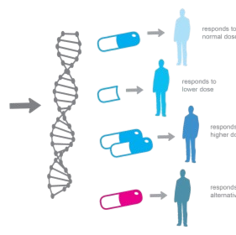
A new method for patient stratification based on multi-layer network modeling and molecular data integration
Cohorts
GBM (n = 215)
BIC (n = 105)
KRCCC (n = 124)
LSCC (n = 105)
COAD (n = 92)
NSCLC (n = 393)
Iterated Generalized Louvain + Lloyd K-Means.
Findings
Improvement of SNF Method (State-Of-The-Art).
Significant Patients Stratification.
Enrichment Clinical Variables.
Conclusions
Therapy Optimization for Precision Oncology.

